Slide 1
Chapter 8
Application: The Costs of Taxation
Professor Galvez-Soriano lecture notes. Based on N. Gregory Mankiw, Principles of Microeconomics, 9th Edition.

Slide 2
Deadweight Loss of Taxation
Tax on a good levied on buyers
Demand curve shifts downward
By the size of tax
Tax on a good levied on sellers
Supply curve shifts upward
By the size of tax
Professor Galvez-Soriano lecture notes. Based on N. Gregory Mankiw, Principles of Microeconomics, 9th Edition.

Slide 3
Deadweight Loss of Taxation
Tax on a good levied on buyers or on sellers
Same outcome: a price wedge
Price paid by buyers rises
Price received by sellers falls
Lower quantity sold
Professor Galvez-Soriano lecture notes. Based on N. Gregory Mankiw, Principles of Microeconomics, 9th Edition.

Slide 4
Deadweight Loss of Taxation
Tax burden
Distributed between producers and consumers
Determined by elasticities of supply and demand
Market for the good
Smaller
Professor Galvez-Soriano lecture notes. Based on N. Gregory Mankiw, Principles of Microeconomics, 9th Edition.

Slide 5
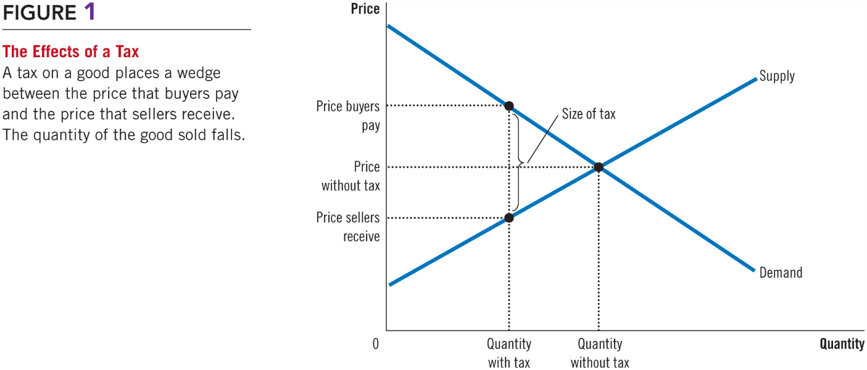
Figure 1 The Effects of a Tax
Professor Galvez-Soriano lecture notes. Based on N. Gregory Mankiw, Principles of Microeconomics, 9th Edition.

Slide 6
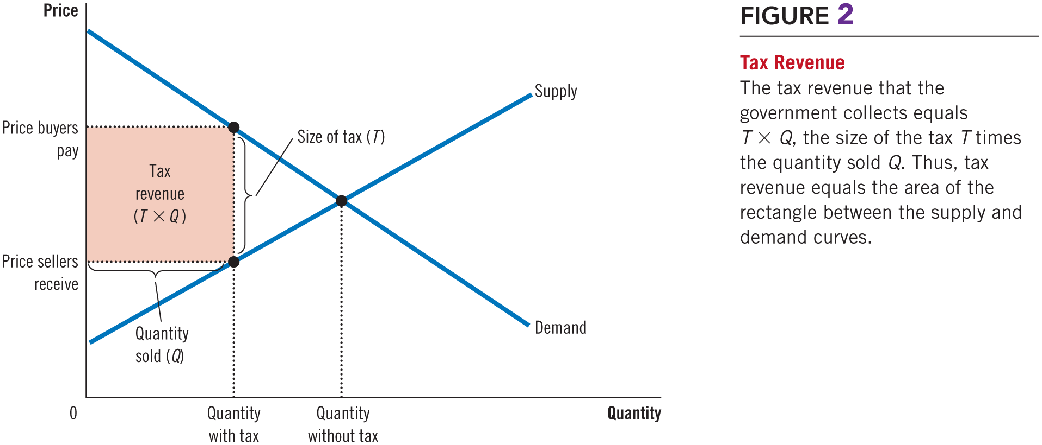
Figure 2 Tax Revenue
Professor Galvez-Soriano lecture notes. Based on N. Gregory Mankiw, Principles of Microeconomics, 9th Edition.

Slide 7
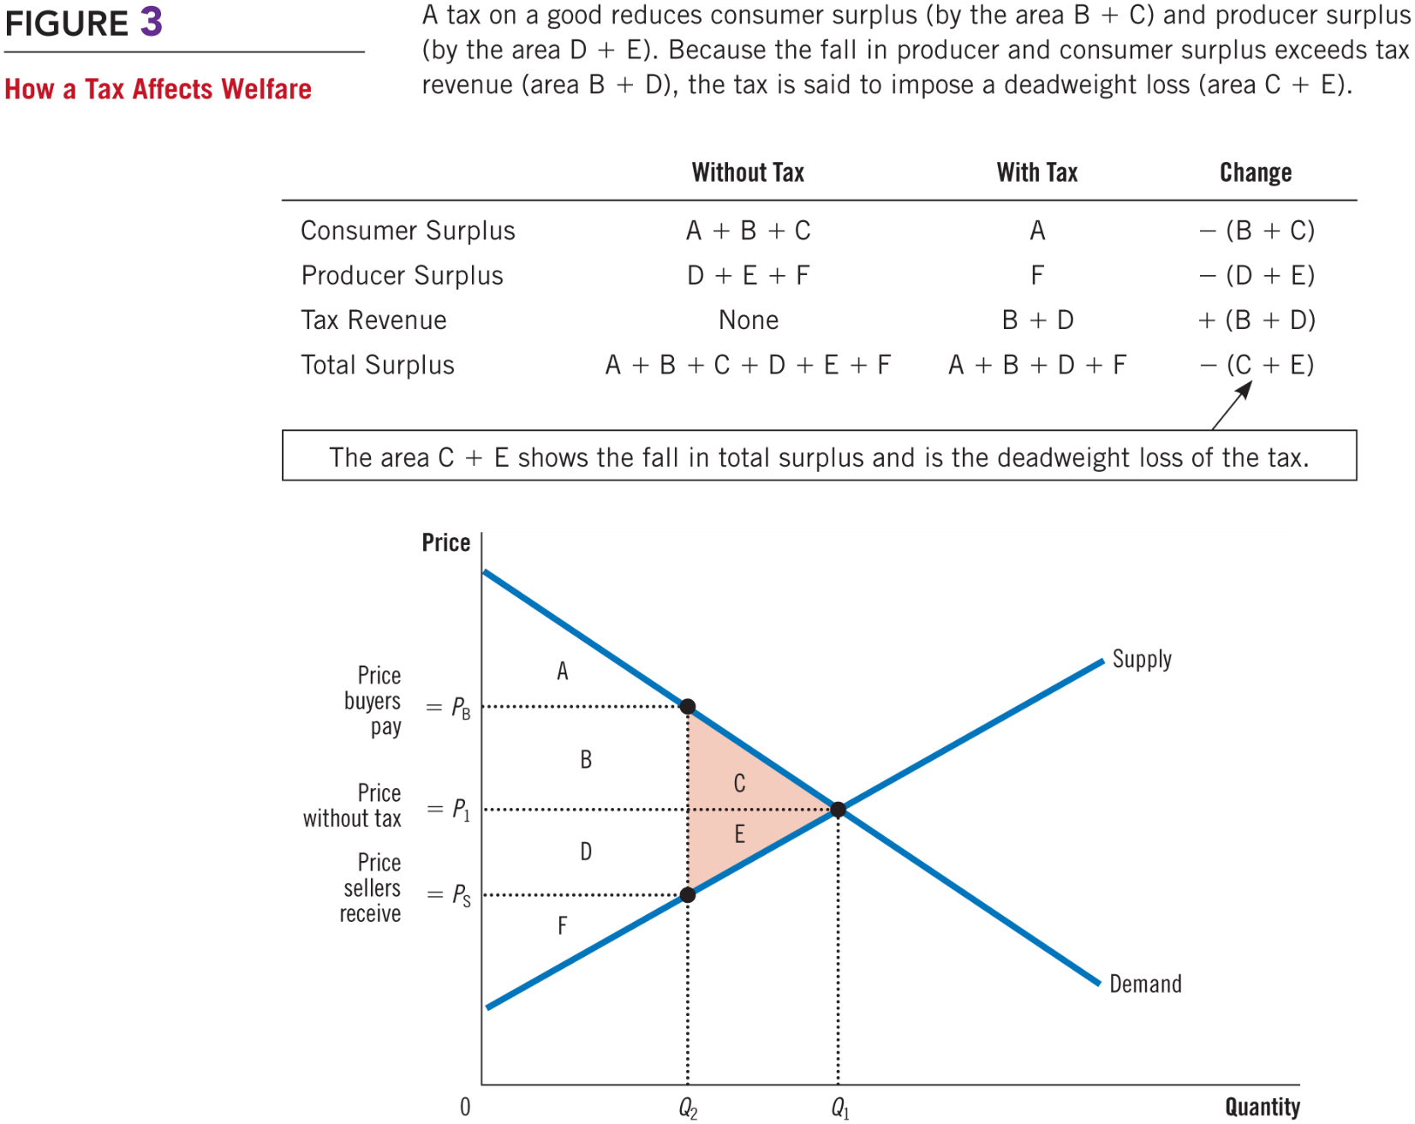
Figure 3 How a Tax Affects Welfare
Professor Galvez-Soriano lecture notes. Based on N. Gregory Mankiw, Principles of Microeconomics, 9th Edition.
Notes:
Welfare without a tax
Consumer surplus, areas A, B, and C
Producer surplus, areas D, E, and F
Total tax revenue = 0
Welfare with tax
Smaller consumer surplus, area A
Smaller producer surplus, area F
Total tax revenue, areas B and D
Smaller overall welfare

Slide 8
Deadweight Loss of Taxation
Deadweight losses and gains from trade
Taxes cause deadweight losses
Prevent buyers and sellers from realizing some of the gains from trade
The gains from trade
Difference between buyers’ value and sellers’ cost are less than the tax
Once the tax is imposed some trades are not made: deadweight loss
Professor Galvez-Soriano lecture notes. Based on N. Gregory Mankiw, Principles of Microeconomics, 9th Edition.

Slide 9
Determinants of Deadweight Loss
Price elasticities of supply and demand
More elastic supply curve
Larger deadweight loss
More elastic demand curve
Larger deadweight loss
The greater the elasticities of supply and demand
The greater the deadweight loss of a tax
Professor Galvez-Soriano lecture notes. Based on N. Gregory Mankiw, Principles of Microeconomics, 9th Edition.

Slide 10
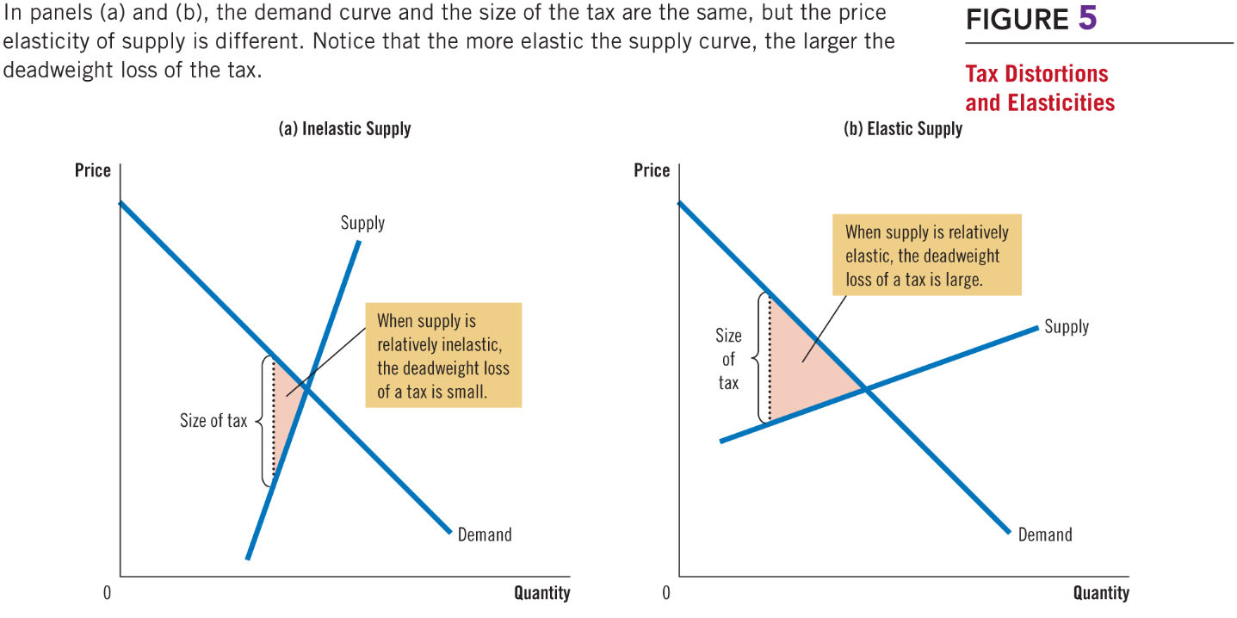
Figure 5 Tax Distortions and Elasticities (a, b)
Professor Galvez-Soriano lecture notes. Based on N. Gregory Mankiw, Principles of Microeconomics, 9th Edition.

Slide 11
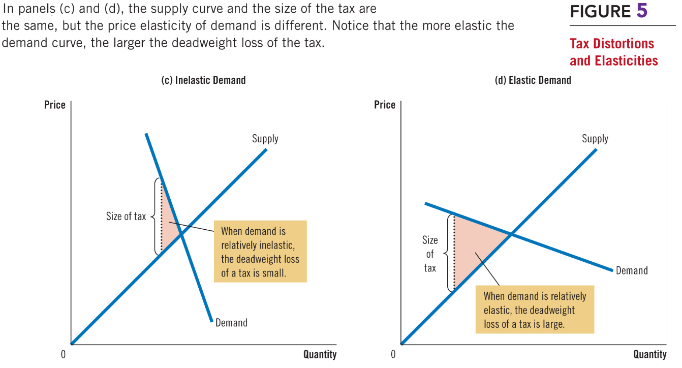
Figure 5 Tax Distortions and Elasticities (c, d)
Professor Galvez-Soriano lecture notes. Based on N. Gregory Mankiw, Principles of Microeconomics, 9th Edition.

Slide 12
Deadweight Loss & Tax Revenue
As the tax increases
Deadweight loss increases
Even more rapidly than the size of the tax
Tax revenue
Increases initially
Then decreases
The higher tax: drastically reduces the size of the market
Professor Galvez-Soriano lecture notes. Based on N. Gregory Mankiw, Principles of Microeconomics, 9th Edition.

Slide 13
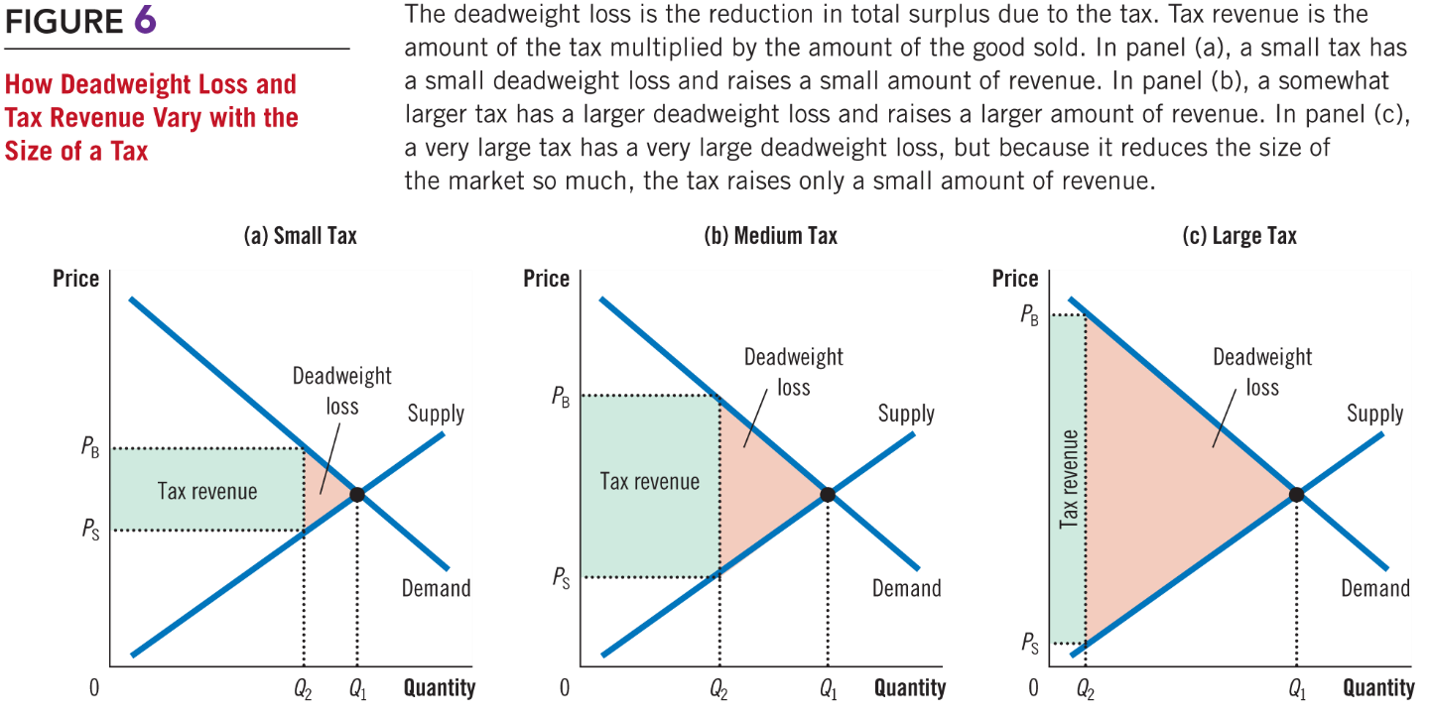
Figure 6 How Deadweight Loss and Tax Revenue Vary with the Size of a Tax (a, b, c)
Professor Galvez-Soriano lecture notes. Based on N. Gregory Mankiw, Principles of Microeconomics, 9th Edition.

Slide 14
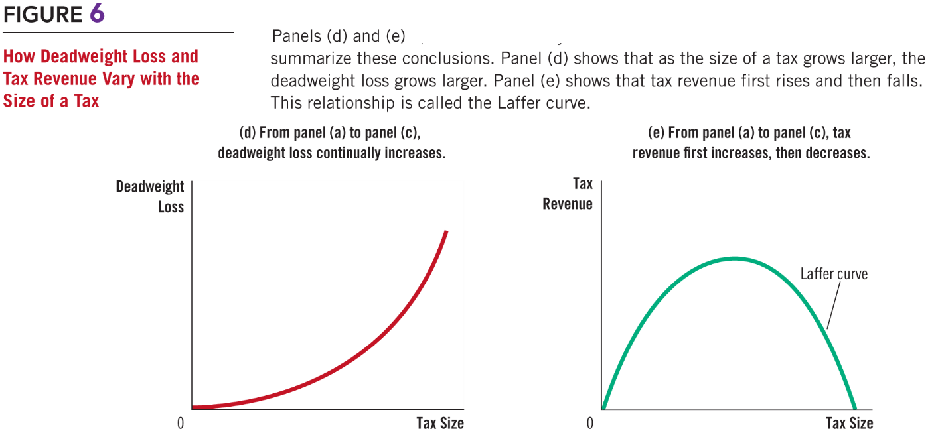
Figure 6 How Deadweight Loss and Tax Revenue Vary with the Size of a Tax (d, e)
Professor Galvez-Soriano lecture notes. Based on N. Gregory Mankiw, Principles of Microeconomics, 9th Edition.

